Slide 1
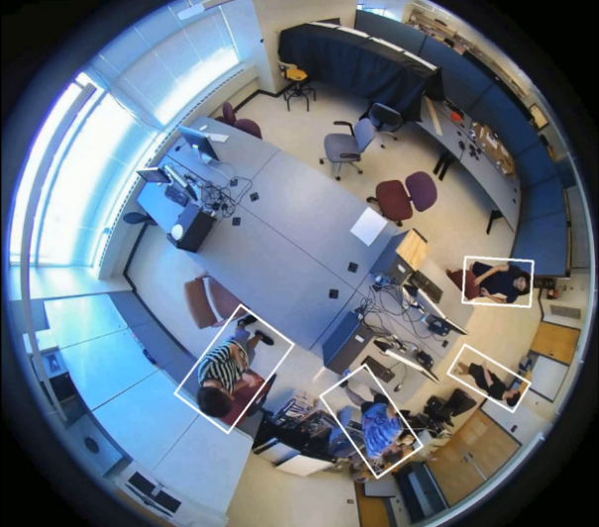
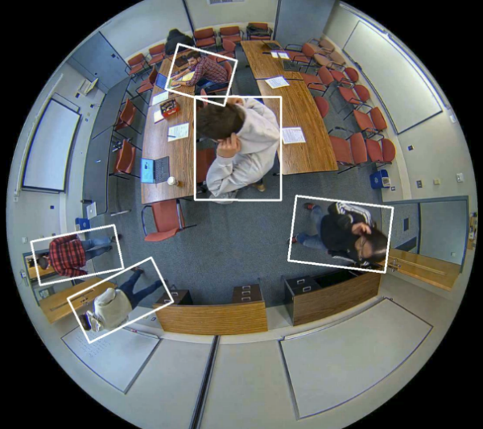
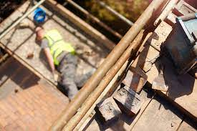
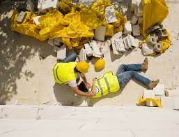
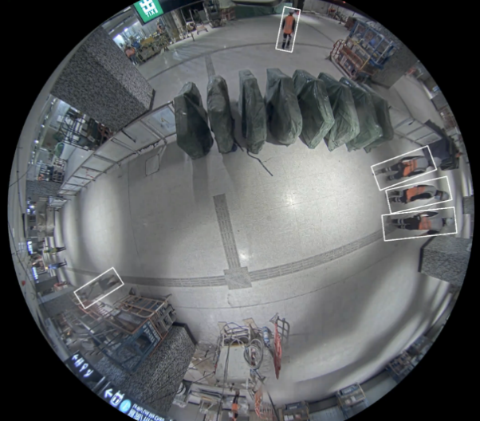
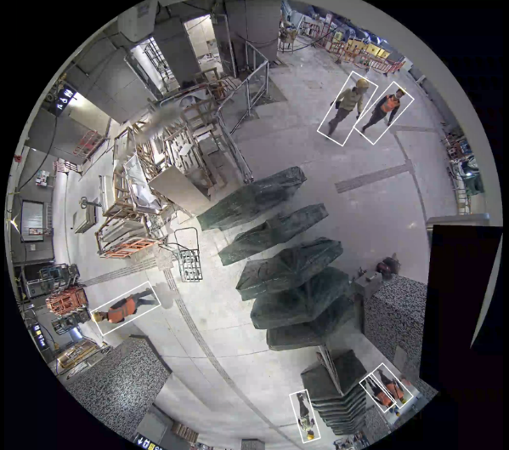
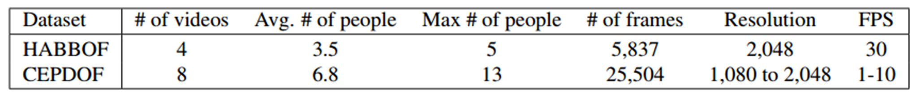
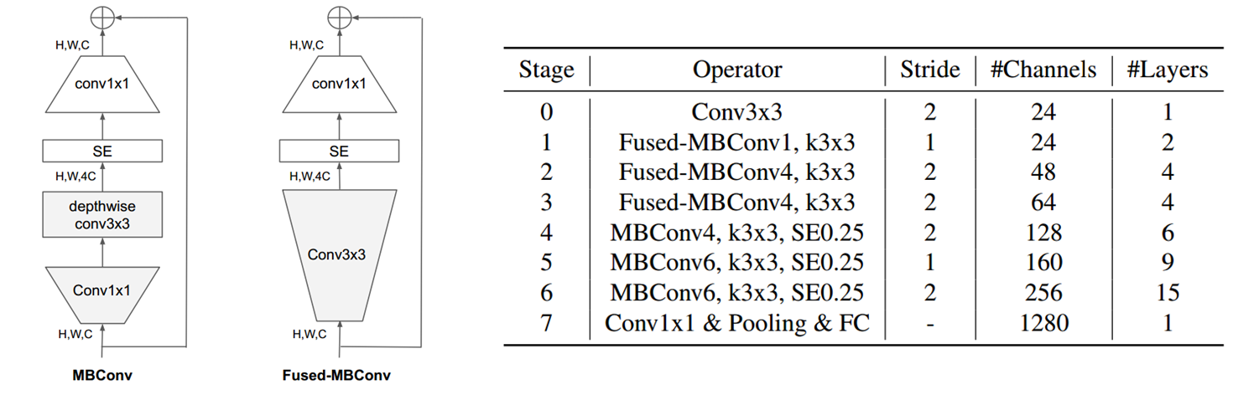
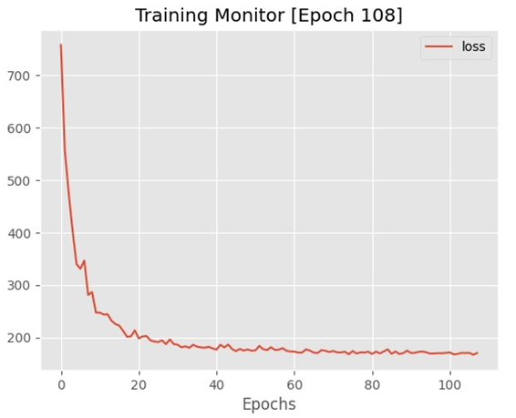
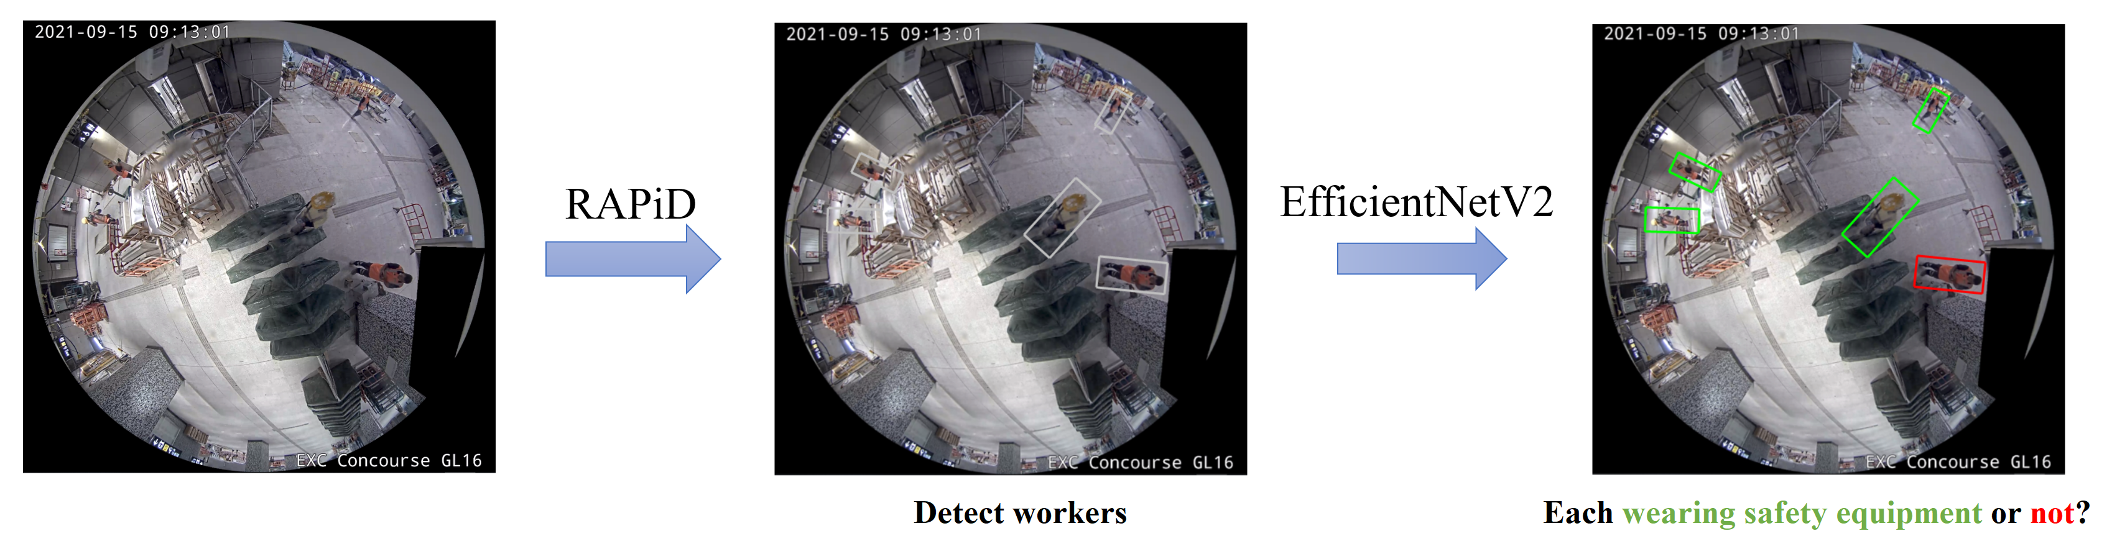
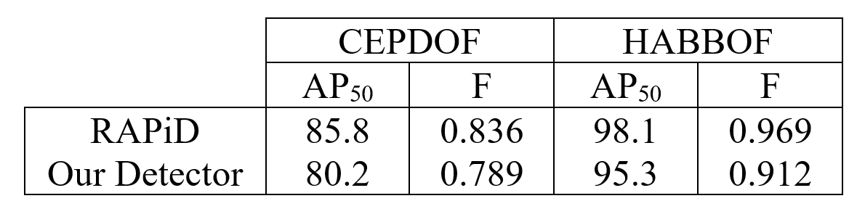
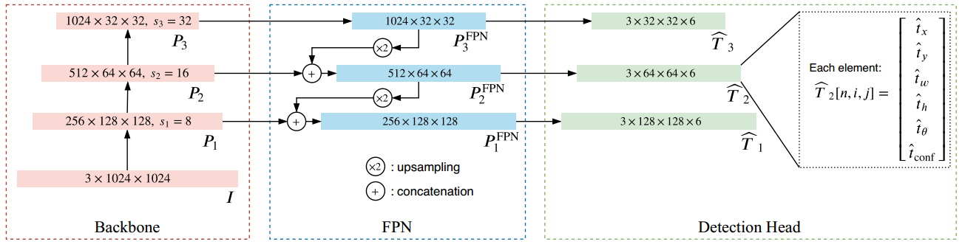
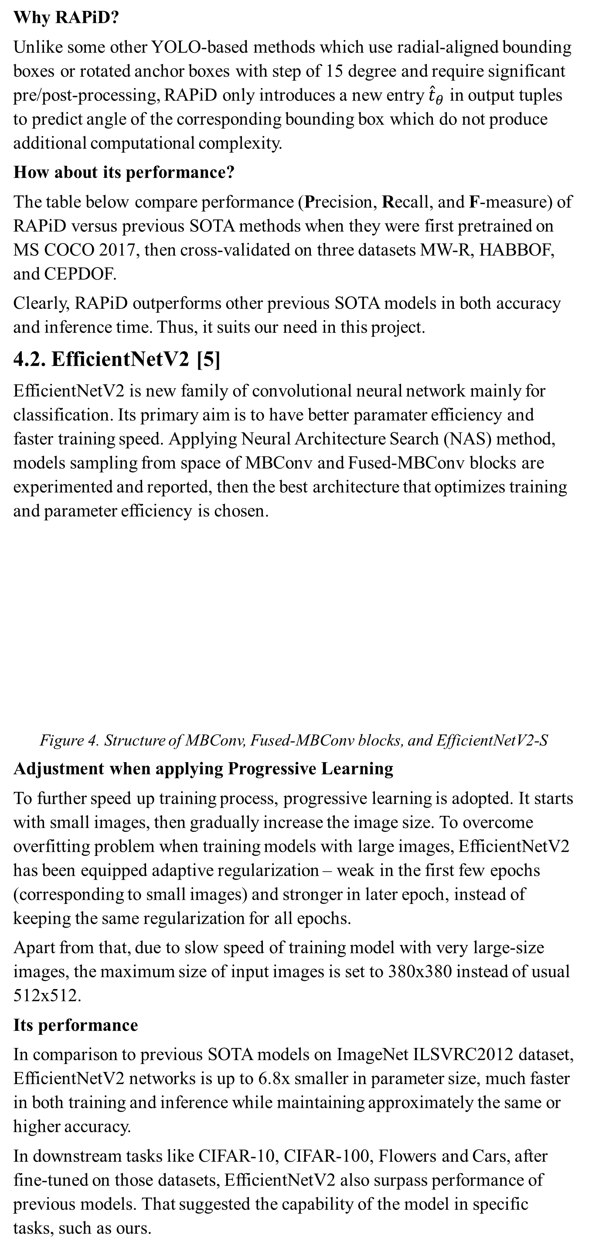
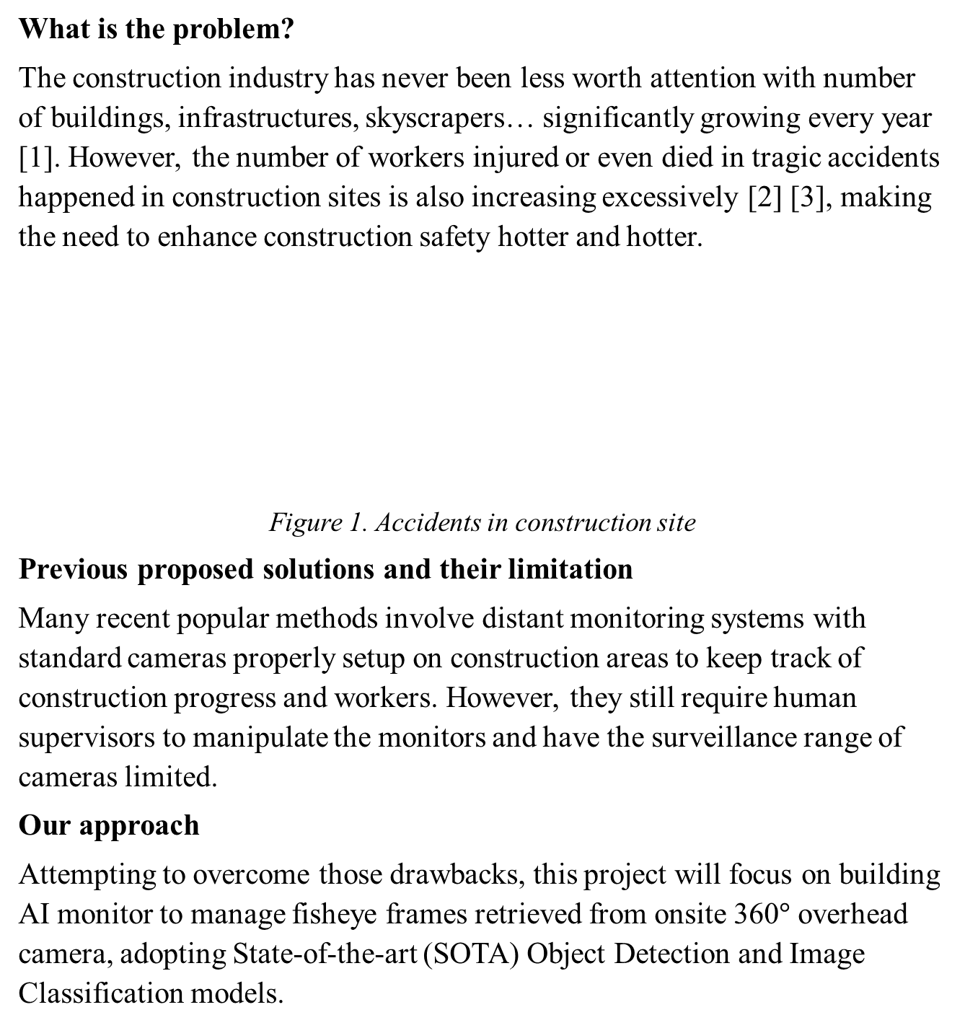
MATH 4995 Milestone Report 1: Workers Supervision for Construction Safety
PHAM Trung Kien, DO Van Quyet {tkpham, vqdo}@connect.ust.hk
Department of Mathematics, HKUST
1. INTRODUCTION
recall metrics and is expected to reach 90% or more in every criterion for any category of safety equipment. Also, thank to the model’s relatively small size, we expect to get fast inferences.
Why RAPiD?
Unlike some other YOLO-based methods which use radial-aligned bounding boxes or rotated anchor boxes with step of 15 degree and require significant pre/post-processing, RAPiD only introduces a new entry ${\hat{t}}_{θ}$ in output tuples to predict angle of the corresponding bounding box which do not produce additional computational complexity.
How about its performance?
The table below compare performance (Precision, Recall, and F-measure) of RAPiD versus previous SOTA methods when they were first pretrained on MS COCO 2017, then cross-validated on three datasets MW-R, HABBOF, and CEPDOF.
Clearly, RAPiD outperforms other previous SOTA models in both accuracy and inference time. Thus, it suits our need in this project.
4.2. EfficientNetV2 [5]
EfficientNetV2 is new family of convolutional neural network mainly for classification. Its primary aim is to have better paramater efficiency and faster training speed. Applying Neural Architecture Search (NAS) method, models sampling from space of MBConv and Fused-MBConv blocks are experimented and reported, then the best architecture that optimizes training and parameter efficiency is chosen.
Figure 4. Structure of MBConv, Fused-MBConv blocks, and EfficientNetV2-S
Adjustment when applying Progressive Learning
To further speed up training process, progressive learning is adopted. It starts with small images, then gradually increase the image size. To overcome overfitting problem when training models with large images, EfficientNetV2 has been equipped adaptive regularization – weak in the first few epochs (corresponding to small images) and stronger in later epoch, instead of keeping the same regularization for all epochs.
Apart from that, due to slow speed of training model with very large-size images, the maximum size of input images is set to 380x380 instead of usual 512x512.
Its performance
In comparison to previous SOTA models on ImageNet ILSVRC2012 dataset, EfficientNetV2 networks is up to 6.8x smaller in parameter size, much faster in both training and inference while maintaining approximately the same or higher accuracy.
In downstream tasks like CIFAR-10, CIFAR-100, Flowers and Cars, after fine-tuned on those datasets, EfficientNetV2 also surpass performance of previous models. That suggested the capability of the model in specific tasks, such as ours.
5. PRELIMINARY RESULT
detected person or worker can be observed in Figure 6. Note that white bounding boxes are drawn for each detected person.
What is the problem?
The construction industry has never been less worth attention with number of buildings, infrastructures, skyscrapers… significantly growing every year [1]. However, the number of workers injured or even died in tragic accidents happened in construction sites is also increasing excessively [2] [3], making the need to enhance construction safety hotter and hotter.
Figure 1. Accidents in construction site
Previous proposed solutions and their limitation
Many recent popular methods involve distant monitoring systems with standard cameras properly setup on construction areas to keep track of construction progress and workers. However, they still require human supervisors to manipulate the monitors and have the surveillance range of cameras limited.
Our approach
Attempting to overcome those drawbacks, this project will focus on building AI monitor to manage fisheye frames retrieved from onsite 360$°$ overhead camera, adopting State-of-the-art (SOTA) Object Detection and Image Classification models.
For our project to be successful, the most important parts are to finish the architecture implementation and training process of the Multi-Person Detector and the Binary Image Classifier. These stages acquire 80% of our project’s workload while 20% left is for making inferences and evaluating models’ performance.
5.1. Multi-Person Detector
Implementing and training
Up to this point, we have finished implementing architecture for our detector, i.e., replicating RAPiD model based on its original paper. Additionally, we are making good progress on training and simultaneously fine-tuning our detector on approximately 32000 frames from CEPDOF and HABBOF datasets. Since there is no predefined train-test split in these two datasets, currently all the images are used for the training process for us to get a first glance at our detector’s behavior during this procedure.
Simple resizing augmentation are also adopted for preprocessing the images into 1024x1024 resolution before they are fed into our detector with a batch size of 16. Besides, the detector weights are updated by Stochastic Gradient Descent (SGD) optimizer with the following parameters: learning rate 0.0001, momentum 0.9, and weight decay 0.0005. Until now, the training process of our Multi-Person Detector can be considered as finished after over 100 epochs, which is equivalent to around 200000 feedforward iterations.
The loss is kept tracking after every epoch throughout the whole process (Figure 5). The fact that value of the loss gradually decreases epoch by epoch have affirmed that there is neither implementation error nor logical error occurred in our detector’s architecture and training code.
3. DATASETS
3.1. To train our Detector
We use two datasets, HABBOF and CEPDOF. Both are publicly available, captured by overhead fisheye cameras, and importantly annotated with rotated bounding boxes. While HABBOF has the number of frames and people within a frame limited, also lack of challenging cases, CEPDOF contains many more frames and people, especially challenging scenarios such as crowed room, low-light condition, or various human body poses.
Table 1. Statistics of datasets for object detection on overhead fisheye images
3.2. To train our Classifier
Simultaneously, we have been collecting datasets for training our classifier’s instances by scraping, crawling, and cropping from open sources on the internet like Google Images and Shutterstock.
The two most common safety equipment that we are focusing on are the safety helmet and safety jacket. Dataset consisting of 20000 images for wearing safety helmet classification is ready and waited for training while the one for safety jacket is still under collecting and preprocessing.
Figure 6: The top left frame is from HABBOF, the top right frame is from CEPDOF, and the two bottom frames are from a construction site.
Further improvement
In the upcoming time, we may adopt some techniques to further improve the detector’s performance. They can be cross validating, for example using CEPDOF for training and HABBOF for validating; or hyperparameters tuning, i.e., experimenting different combinations of values for batch size and optimizer’s parameters; and even adopting more complex augmentation methods to diversify dataset.
5.2. Binary Image Classifier
For this component, until now we partially finish implementing its architecture, i.e., EfficientNetV2, and integrating its training code but have not started the training process for its instances yet because we have limited resources to do it concurrently with the detector.
4. METHODOLOGY
2. OBJECTIVES
As mentioned, the AI monitor consists of two task-specified models: RAPiD for object detection on images with fisheye frame and EfficientNetV2 for classification on cropped boxes as the output of RAPiD. Apart from that, some common data augmentation methods are applied in training process to enhance model performance.
Our AI monitor consists of two major components:
a Multi-Person Detector to locate every worker inside input frames
a Binary Image Classifier to determine whether those workers are wearing required types of safety equipment or not.
2.1. Detector
As we put concentration on fisheye frames retrieved from 360º cameras, we will attempt to replicate and retrain Rotation-Aware People Detection (RAPiD) model, which has shown outstanding performance on detecting people inside fisheye frames, to be our detector [4].
As worker object can indeed be considered as person object, we expect that our detector have similar performance comparing to its original paper after being sufficiently trained on the CEPDOF and HABBOF datasets. The performance is measured by Average Precision (AP), i.e., the area under the Precision-Recall curve, as well as F-measure metrics.
2.2. Classifier
After workers’ positions are predicted, bounding boxes will subsequently be cropped and fed into our image classifier to make inferences. Each cropped boxes will be classified into two classes: Wearing all/ Not wearing all safety items.
The model for classification is EfficientNetV2 [5]. After being trained on our self-collected data, it will be tested in terms of accuracy, precision, and
Figure 5: Plot of training loss over epoch
6. REFERENCE
Table 2: Quantitative results comparing to original paper
United Nations Environment Programme. 2020 Global Status Report for Buildings and Construction: Towards a Zero-emission, Efficient and Resilient Buildings and Construction Sector. Nairobi, 2020.
CPWR – The Center for Construction Research and Training. Data Bulletin: Fatal Injury Trends in the Construction Industry, 02 2021
T. Anojan and C. S. A. Siriwardana. A Study to Investigate the Factors Affecting Construction Worker Performance. In 2021 Moratuwa Engineering Research Conference (MERCon), pages 13–18, 2021.
Z. Duan, M. Ozan Tezcan, H. Nakamura, P. Ishwar, and J. Konrad. Rapid: Rotation-aware people detection in overhead fisheye images. In 2020 IEEE/CVF Conference on Computer Vision and Pattern Recognition Workshops (CVPRW), pages 2700–2709, 2020.
M. Tan and Q. V. Le. Efficientnetv2: Smaller models andfaster training.ArXiv, abs/2104.00298, 2021.
Figure 2. End-to-end pipeline of our AI monitor
4.1. RAPiD (Rotation-Aware People Detection) [4]
RAPiD is an end-to-end method for human detection on overhead fisheye images. Noticing the appearance of standing people in the images that is not always in upright position, this method use arbitrarily-rotated bounding boxes to cope with the problem. It extends the architecture of YOLO – one of the most successful algorithms for object detection.
Figure 3. RAPiD architecture
Results
We selected the model weight corresponding to the epoch that has smallest loss for making inferences and evaluation. As expected, our detector performs reasonably well. Its statistics are lower but close to the benchmark published in the original paper. In details, we calculated Average Precision (AP) at IoU = 0.5 (AP50) and F-measure at a fixed 0.3 confidence threshold for our detector on HABBOF, CEPDOF datasets. All metrics are averaged over all the videos in each dataset and recorded in Table 2.
In terms of qualitative results, we run inference of our detector on both the videos from the two training datasets and two more videos retrieved from two 360º cameras of two different angles monitoring a construction site. Some of the best illustrative frames with bounding boxes drawn for each
7. CONTRIBUTION
PHAM Trung Kien: propose and study the topic; implement, train and test models
DO Van Quyet: find and choose proper datasets and models

